Slide 1

Create a Snake Game
By David, Spade, Brian

Slide 2

Motivation and Objectives
Motivation:
Snake is a classic arcade game. Its rules are simple, but its gameplay is captivating.
It's ideal for demonstrating C++ fundamentals like object-oriented design, data structures, and memory management.
It offers opportunities to integrate graphics libraries
- SFML, SDL, or ncurses.
It encourages team collaboration in design, coding, and testing.
Objectives:
Implement a fully functional Snake game with smooth controls and collision detection.
Using object-oriented design. Encapsulate the snake, food, and game engine as separate classes.
Ensure modular, maintainable code with high durability.
Deliver a highly playable, polished game with room for future upgrades (leaderboards, levels, obstacles).

Slide 3
High-level Design
Game Engine: Main loop, refresh, input and output processing.
Snake Class: Manage the body, movement, growth, and collision detection of snakes.
Food Class: Randomly generate food locations.
Map Class: Define game boundaries.
Score Manager: Track and record scores.

Slide 4
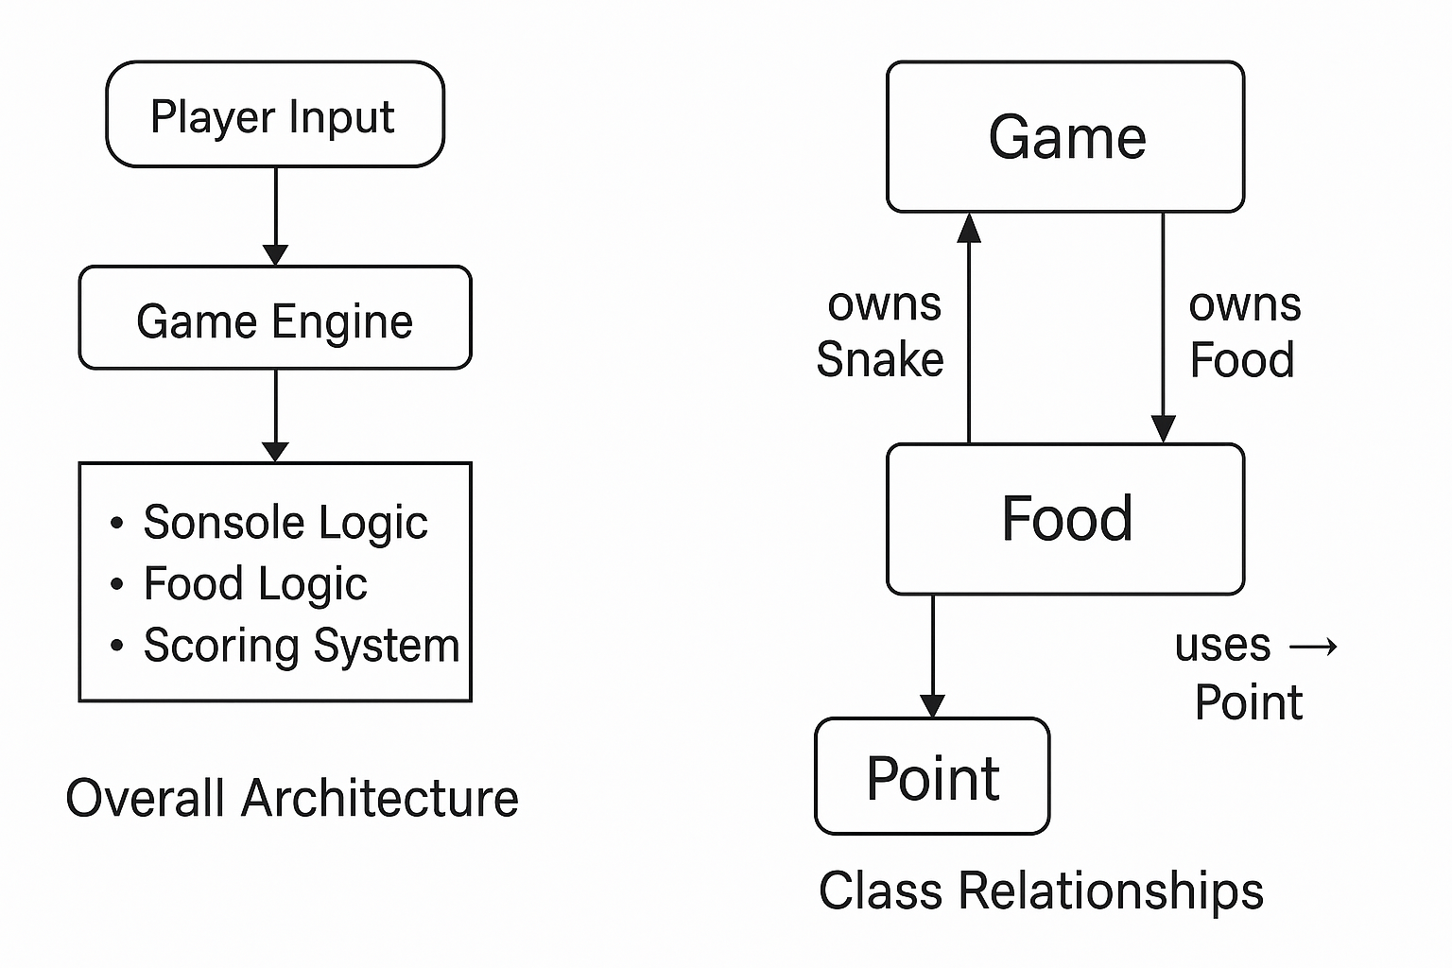
Class Design Plan
Main Classes
Game – Core controller that runs the main loop and manages all components.
Snake – Stores the body and handles movement & self-collision.
Food – Randomly spawns new items on the grid.
Point – Represents coordinate positions used by Snake and Food.
Relationships
Game owns both Snake and Food (composition).
Snake uses Point objects to represent its body.
Food interacts with Game to find available locations.
Design Goal : A clean, modular structure based on object-oriented programming,
making the code easy to extend and maintain.

Slide 5
Software Architecture (Front End vs. Back End)
Frontend
Input Handler Renderer/UI Score Display
Backend
Game Engine Snake, Food, Map Collision Logic
Frontend: Handles user interaction and display, including keyboard input, ASCII/graphical rendering, and score output.
Backend: Manages game state and logic. The game engine coordinates the snake, food, map, and score classes to update positions and detect collisions.
Frontend and backend continuously interact. Player input flows to the engine, which updates state, and the renderer outputs new frames. This separation ensures modular design, easier debugging, and flexibility for future graphical upgrades.

Slide 6
Team Members and Task Assignments
Team Member | Responsibilities
David | Implement core game engine: main loop, timing control, and keyboard input handling. Manage overall project integration and testing.
Spade | Develop Snake and Food classes, including movement logic, collision detection, and food spawning algorithm. Ensure OOP encapsulation and data structure management.
Brian | Handle UI rendering and score tracking. Design ASCII-based visual layout, implement scoring system, and assist with final debugging and presentation slides.

Slide 7
Deliverables and Timeline
Week | Deliverables | Details
Week 1 | Proposal & Design | Finalize the class diagram, select the graphics library, and assign tasks.
Week 2 | Basic Implementation | Snake Movement, Food Generation, Basic Rendering
Week 3 | Game Logic | Collision Detection, Scoring, Game Over Conditions
Week 4 | Polish | UI improvements, optimized visual effects, features
Week 5 | Testing & Documentation | Debugging, code cleanup, final report
Week 6 | Final Presentation | Demo game, presentation, lessons learned

Slide 8
References
GeeksforGeeks – How to Build a Simple Snake Game in C++ (Console Version)
cplusplus.com – Reference Documentation for STL Containers and <chrono> Library
SFML Documentation – For future graphical extensions and rendering ideas
GitHub repository: https://github.com/silence1772/GreedySnake

